Slide 1
MULTIFINANCE OUTLOOK 2013
ASOSIASI PERUSAHAAN PEMBIAYAAN INDONESIA
INDONESIAN FINANCIAL SERVICES ASSOCIATION
Dennis Firmansjah
Advisor, Indonesian Financial Services Association

Slide 2
INDONESIA MACROECONOMIC CONDITION

Slide 3
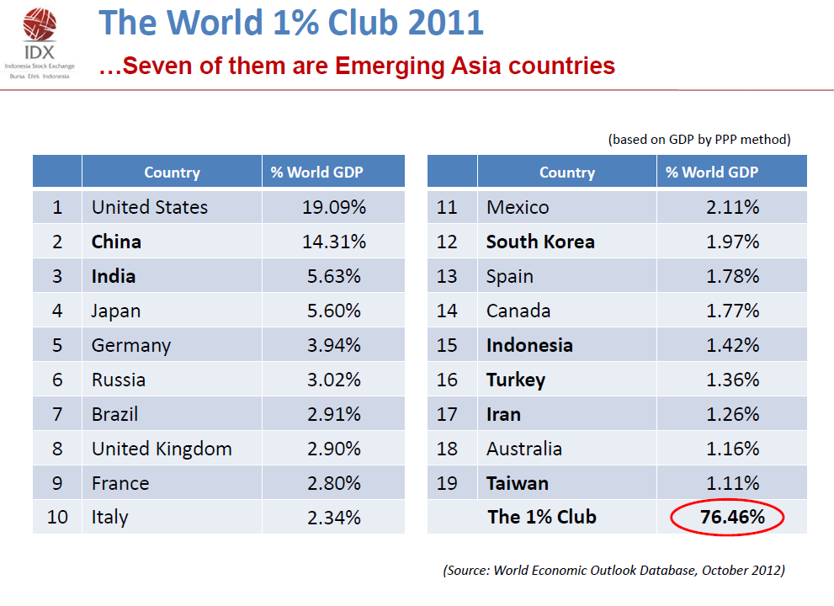

Slide 4
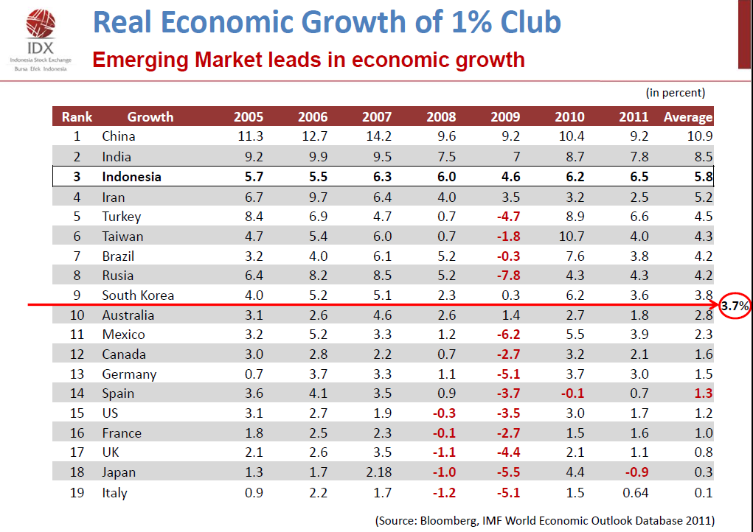

Slide 23
MULTIFINANCE Companies Performance September 2012

Slide 24
Multifinance Industry Highlight
In million of USD
Description | Dec-05 | Dec-06 | Dec-07 | Dec-08 | Dec-09 | Dec-10 | Dec-11 | Sep-12
No. Of Companies | 236 | 214 | 217 | 212 | 198 | 192 | 196 | 196
Total Asset | 10.034 | 11.463 | 13.396 | 17.732 | 18.362 | 24.242 | 30.672 | 35.266
Account Receivable | 6.996 | 9.803 | 11.335 | 14.446 | 15.004 | 19.616 | 25.821 | 31.288
Loans | 6.334 | 6.887 | 8.155 | 11.564 | 10.733 | 15.296 | 19.713 | 22.191
Bonds | 1.071 | 1.062 | 1.352 | 1.210 | 1.431 | 1.936 | 3.188 | 4.477
Paid in Capital | 1.161 | 1.161 | 1.345 | 1.550 | 1.830 | 1.962 | 2.155 | 2.708
Nett Profit/ Loss | 367 | 367 | 330 | 461 | 671 | 824 | 940 | 977

Slide 25
FINANCING ACTIVITIES
In million of USD
DETAIL | Dec-05 | Dec-06 | Dec-07 | Dec-08 | Dec-09 | Dec-10 | Dec-11 | Sep-12
Leasing | 2.010 | 3.436 | 3.840 | 5.335 | 4.898 | 5.597 | 8.062 | 11.316
Factoring | 149 | 137 | 232 | 234 | 213 | 242 | 412 | 429
Credit Card | 186 | 155 | 152 | 121 | 98 | 92 | 0 | 0
Consumer Finance | 4.652 | 6.074 | 7.112 | 8.757 | 9.795 | 13.686 | 17.346 | 19.543
TOTAL | 6.996 | 9.803 | 11.335 | 14.446 | 15.004 | 19.616 | 25.821 | 31.288

Slide 26
Financing Activities Portfolio

Slide 27
NPL Multifinance
Financing Sector | Dec'2011 | Sept'2012
Leasing | 0.32% | 0.29%
Factoring | 2.81% | 1.99%
Credit Card | NA | NA
Consumer Finance | 1.59% | 1.62%
Total | 1.21% | 1.14%

Slide 28
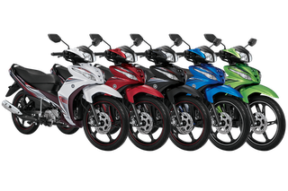
THE
RELATED INDUSTRY

Slide 29
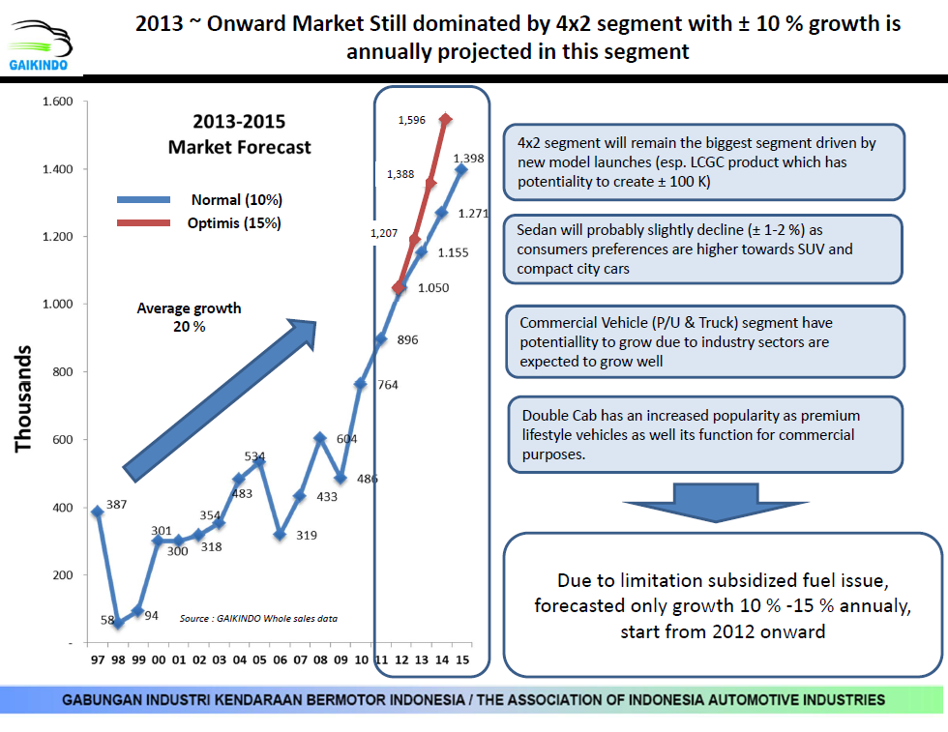
REVIEW OF CAR MARKET IN INDONESIA

Slide 30
CAR 2012 PERFORMANCE

Slide 31
MOTORCYCLES SALES
Oct 12

Slide 32
Data source PAABI

Slide 33
Data source PAABI

Slide 34
OPPORTUNITIES IN 2013
Indonesian economic growth is estimated at 6.5%
High demand of transportation needs
Low Cost Green Car Program (LCGC)
Infrastructure Development

Slide 35
Challenges in 2013
The plan to implement minimum down payment for Sharia Financing
The Implementation of Fiduciary Regulation
Regulation on subsidized fuel restriction
The decreasing demand of coal and cpo worldwide, and restriction of unprocessed raw material/natural resources export will impact HE/Trucks financing demands

Slide 36
THANK YOU

